Slide 1
CS4460 FINAL REVIEW
2019-04-30

Slide 2
User interaction overview
S. Few: the effectiveness of information visualization hinges on two things: its ability to clearly and accurately represent information and out ability to interact with it to figure out what the information means.
Interaction is often “little brother” of InfoVis. Recall two main components in an infovis: representation, interaction.
Interaction is what distinguishes infovis from static visual representations on paper.
Challenges
Interaction seems to be a difficult thing to pin down and characterize
User-centered V.S system-centered characterizations
Let’s go back to user trying to solve problems, explore and get insight: Analysis is a continuous process of understanding new information, asking new questions, seeking new understanding and so on and so forth.
See interaction as a user-centered way to elicit information from data

Slide 3
User interaction interaction types
Dix and Ellis propose
Highlighting and focus
Accessing extra into – drill down (深层研究) and hyperlinks
Overview and context – zooming and fisheyes
Same representation, changing parameters
Linking representations – temporal fusion
Keim’s taxonomy
Projection
Filtering
Zooming
Distortion
Linking and brushing

Slide 4
User interaction interaction types
Few’s Principles – especially useful ways of interacting with data
Comparing
Sorting
Adding variables
Filtering
Highlighting
Aggregating
Re-expressing
Re-visualizing
Zooming and panning (摄像头水平移动)
Re-scaling
Accessing details on demand
Annotating
Bookmarking

Slide 5
User interaction user intent
User intent - What a user wants to achieve through a specific interaction technique.
Main idea – Interaction is ultimately being done by a person for a purpose.
Seeking information, solving a problem
Fundamental aspect of exploratory, analytic discourse (对话、交流)
Results – When you categorize interaction types by user intent, the user’s intent is usually the task they are trying to perform. (7 categories)

Slide 6
User interaction user intent
Select → “Mark something as interesting”
Mark items to keep track
Often as a preceding action to subsequent operations.
Can be implemented as:
Pop-up tooltips – Hovering mouse cursor brings up details of item.
Mouse selection – clicking on an item selects it and attributes of the data point are shown on the side.
Potential difficulty: Where to place the labels?
Labeling is difficult when so many entities exist
When you select multiple objects, where to place all the information in a way that makes sense
Generalized Selection (select all items that match attributes/precision of selection)
Maybe you want to select items matching some attributes of the item you clicked on.
Maybe you want items that are nearby your selection?

Slide 7
User interaction user intent
Explore → “Show me something different”
Enable users to examine a different subset of data
Overcome the limitation of display size
Example: Direct Walk
Linkages between cases
Exploring one may lead to another (like following hyperlinks on web pages)

Slide 8
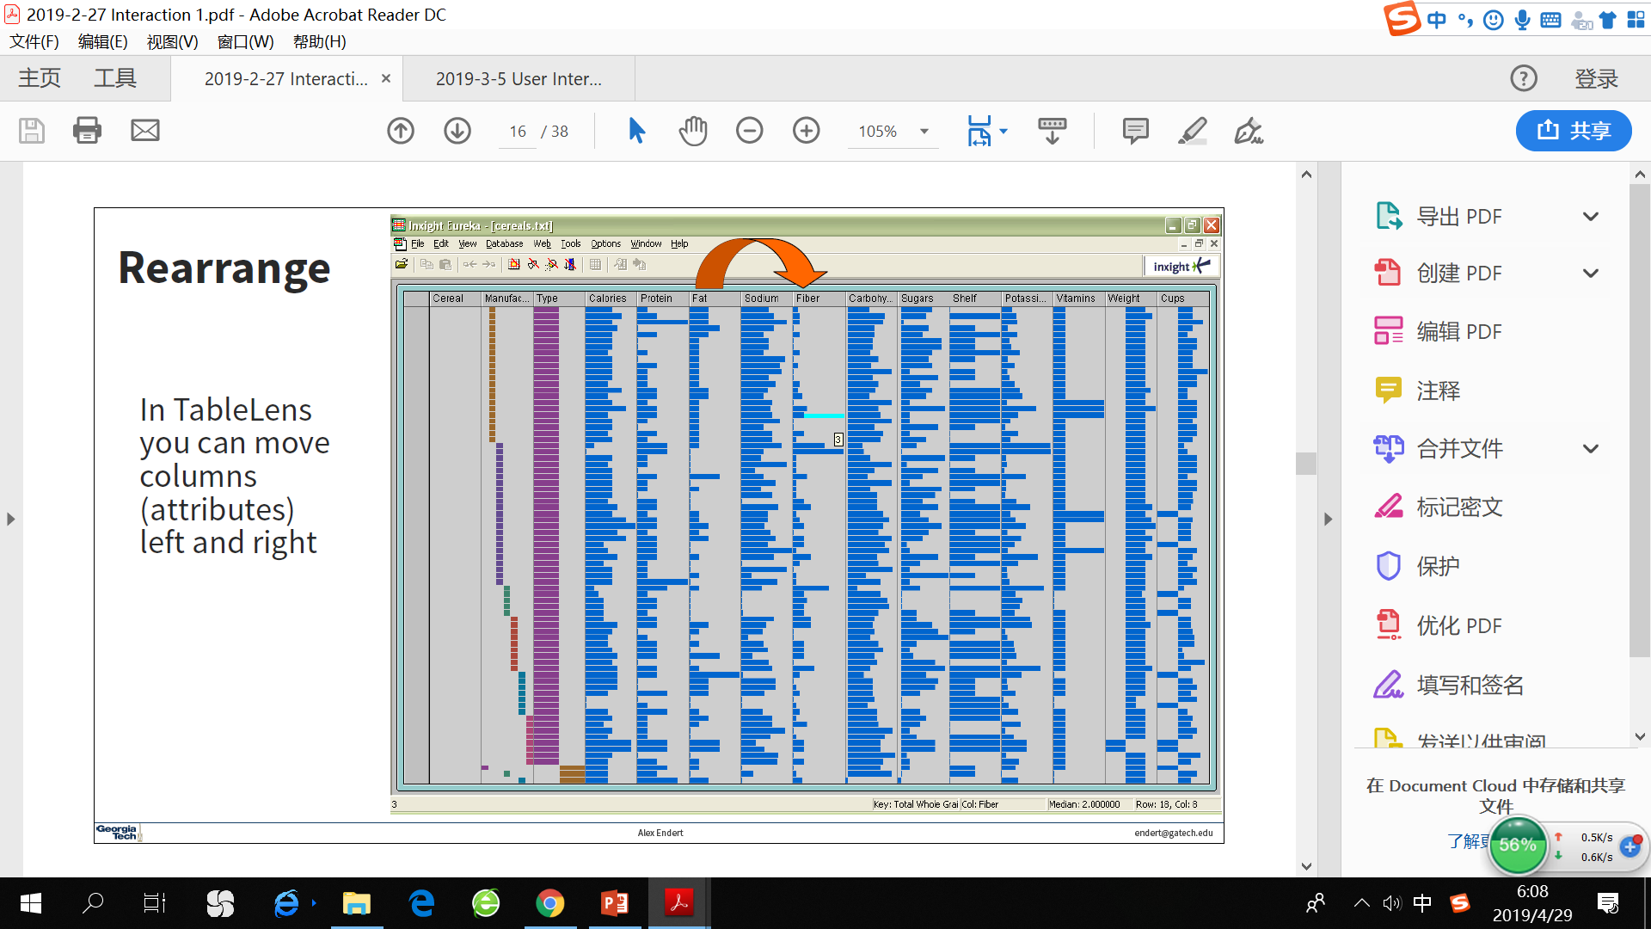
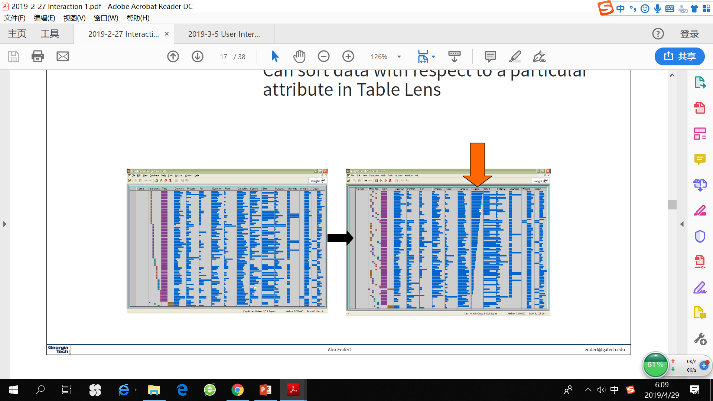
User interaction user intent
Reconfigure → “Show me a different arrangement”
Provide different perspectives by changing the spatial arrangement of representation
Example:
Change the order to columns in TableLens
Sorting with respect to a particular attribute (column)
Changing the attributes in a scatter plot
The “Spread Dust” feature in Dust&Magnet

Slide 9
User interaction user intent
Encode → “Show me a different representation
Change visual appearances
Example:
Color encoding
Size
Orientation
Font
Shape

Slide 10
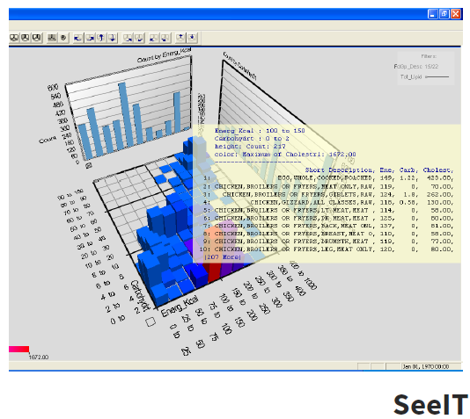
User interaction user intent
Abstract/Elaborate → “Show me more or less detail”
Adjust level of abstraction (overview and details)
Detials-on-Demand
May just be more info about a case
May be moving from aggregation view to individual view (in aggregation view, may not be showing all the data due to scale problem, may just be showing abstraction of groups of elements, like representing a subtree as a triangle)
Example:
Unfolding sub-categories in an interactive pie chart
Drill-down in Treemap
Details-on-demand in Sunburst
The tool-tip operation in SeelT
Geometric zooming

Slide 11
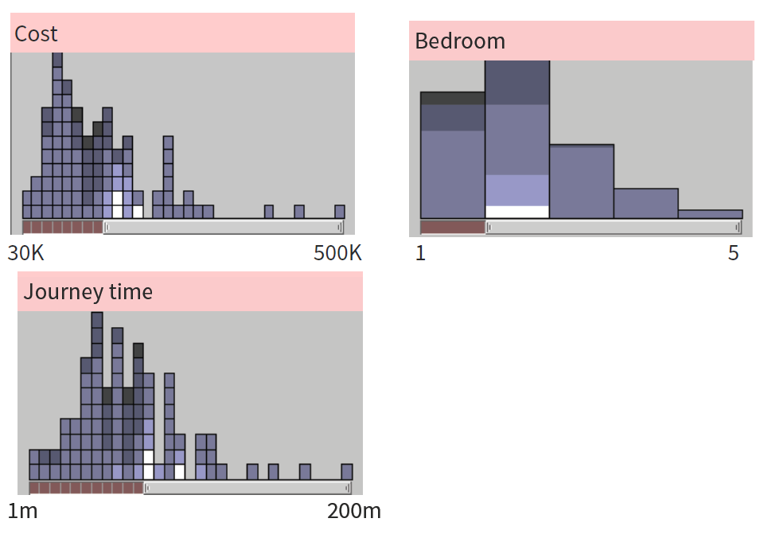
User interaction user intent
Filtering/Limiting → “Show me something conditionally
Change the set of data items being presented
Focusing
Narrowing/widening
Example:
Dynamic query
Attribute Explorer
Keystoke based filtering in NameVoyager

Slide 12
User interaction user intent
Dynamic query
Probably best-known and one of most useful Infovis techniques.
Query language: SELECT house-address FROM atl-realty-db WHERE price >= 200,000 and price <= 400,000 and bathrooms >= 3 and garage == 2 and bedrooms >= 4.
Typical query response: 124 hits found − 1. 748 Oak St. 2. 623 Pine Ave. ... / 0 hits found
Dynamic query constituents
Rapid, incremental and reversible actions (promote reversing/undo)
Selection by pointing (not typing)
Immediate and continuous display of results

Slide 13
User interaction user intent
^_^:
Powerful, flexible
Brings immediate display of results
>_<:
Must learn the language
Only shows exact matches
No helpful context is shown
Operations are fundamentally conjunctive – can only get combinations of specifications, not “either... or...”
Controls take space !!! – Interaction junk (how much space is taken up by interaction tools rather than vis)
As dataset grows larger, dynamic queries become more computationally difficult.

Slide 14
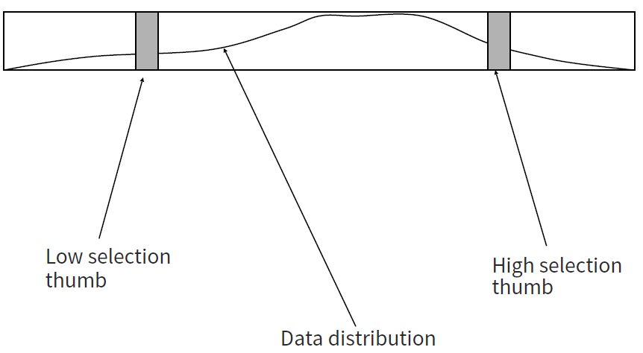
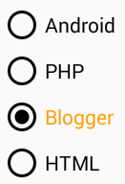
User interaction user intent
Query controls
Binary nominal – Buttons
Nominal with low cardinality – Radio buttons (单选按钮)
Ordinal, quantitative – Sliders
Put data in controls
Do not completely separate the area users use to control the vis and the area for showing the data.
Data Visualization Sliders
Control in the visualization
Dust&Magnet

Slide 15
User interaction user intent
Efficient storage – Data Structures (As data set gets larger, real-time interaction becomes increasingly difficult)
Linear array
Grid file
K-d trees
Bit vectors

Slide 16
User interaction user intent
Connect → “Show me related items”
Highlight associations and relationships
Show hidden items that are relevant to a specified item
Viewer may wish to view the same data cases under different perspectives or representations simultaneously, need to keep straight where the data cases are.
Brushing & Linking
Applies when you have multiple views of the same data

Slide 17
User interaction interaction characteristics
Fluidity Design Guidelines
Provide immediate visual feedback.
Use smooth animated transitions between states.
Minimize indirection (want to promote the idea that the operation make sense in terms of where they are placed).
Integrate UI components in the visual representation.
Ensure that interaction never “ends” (new question -> exploration, so on and so forth).
Avoid explicit mode changes. (No harsh transition between modes)
Animation for Transitions
Animation can help “soften the blow” when a view changes.
Preserve context, allow the viewer to track where things went.

Slide 18
User interaction interaction characteristics
Design Principles
Congruence (mental matching)
Use consistent syntactic-semantic mappings
Respect semantic correspondence.
Apprehension (easily perceivable)
Group similar transitions
Minimize occlusion
Use staging for complex transitions (you would want to use simple transitions as much as possible)
Make transitions as long as needed (keep track of where things went), but no longer

Slide 19
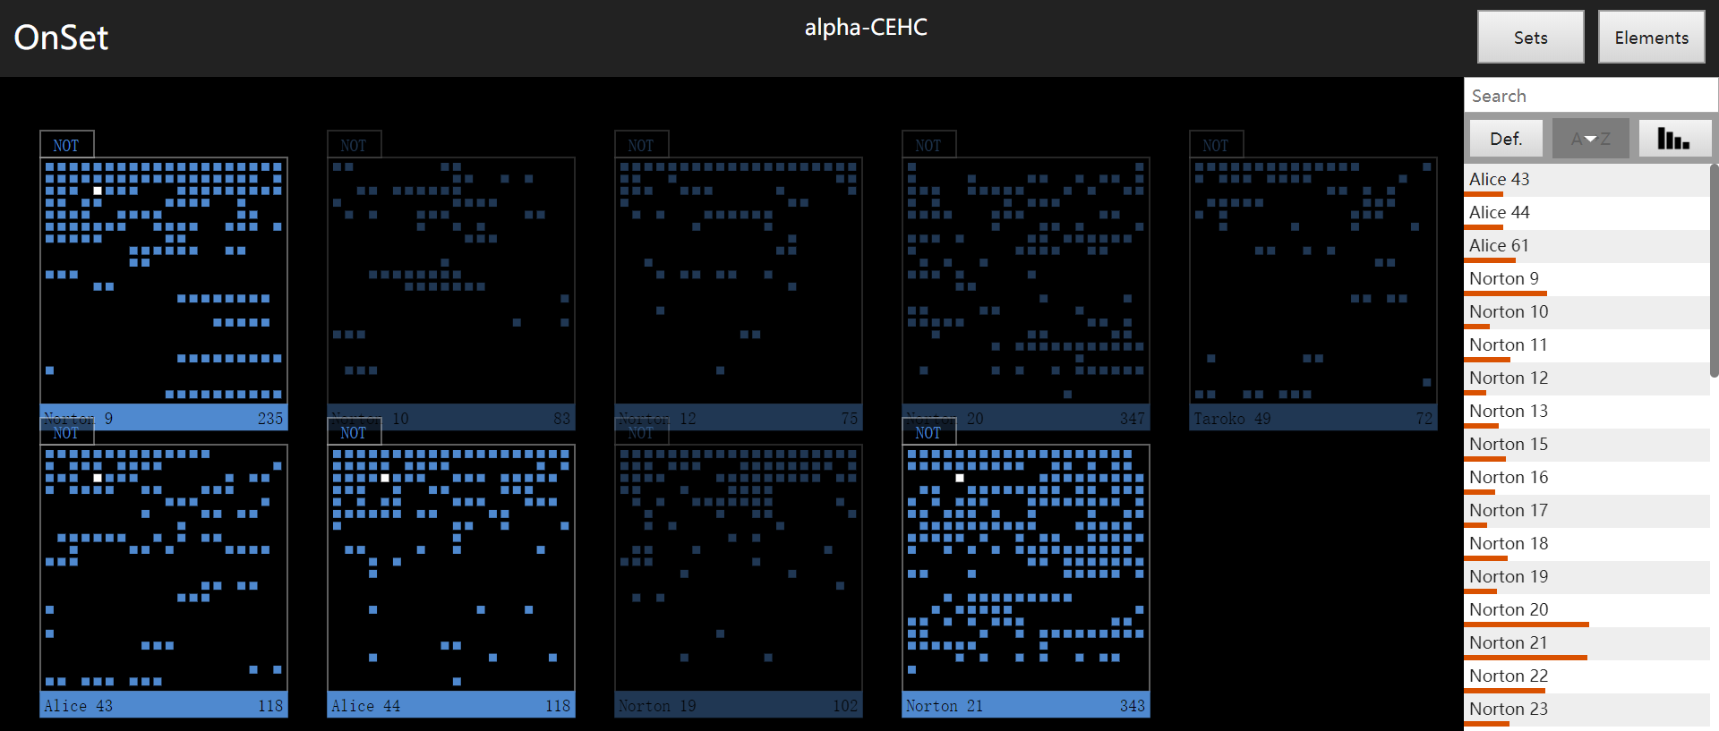
User interaction supporting representation
Interaction in many cases is vital to representation.
Some representation simply do not work without interaction!

Slide 20
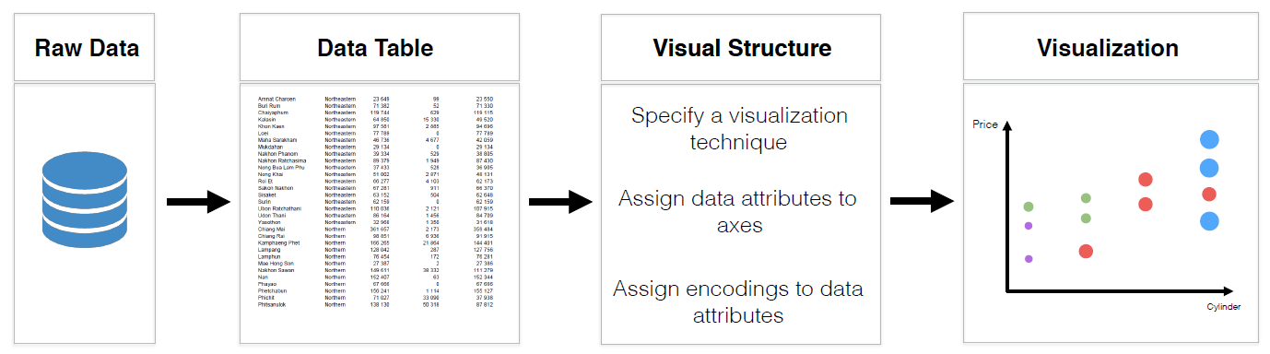
User interaction visualization by demonstration
Recommending Potential Transformations
Visualization representation transformations
Example: recommend possible scatterplots/bar charts.
Data mapping transformations
Axes transformations
Example: recommend data attributes for x/y axis.
View specification transformations

Slide 21
User interaction visualization by demonstration
Information visualization
Bind data values to graphical encodings to produce interactive visual representations of data.
Forster analytic discourse with the data through user interaction.
Discovery
Sensemaking
Enable specific tasks
Visualization by demonstration is an example of one of the two ways to make a better use of the space. (we have said controls take up space)
→ place controls into visualization

Slide 22
User interaction key points
Interaction facilitates a dialog between the user and the visualization system.
Multiple views amplify importance of interaction.
Connect multiple views using brushing & linking.
Interaction often helps when you just cannot show everything you want at one time.

Slide 23
Text Tasks & Goals
What kinds of analysis questions might a person ask about text & documents?
Which documents contain text on topic XYZ?
Are there any other documents that are similar to this one?
What are main themes and ideas in a document of a document collection?
Which documents have an angry tone?
How are certain words to themes distributed through a document?
Understand the history of changes in a document

Slide 24
Text Challenge
Text is nominal data
Does not seem to map to geometric/graphical presentation as easily as ordinal and quantitative data.
No natural “order” or “rank” of documents or words.
The “Raw data → Data Table” mapping becomes more important
Representing text as hypervariate data
Unstructured text → extract entities → high dimensional data → dimension reduction model → choice of visual encodings.

Slide 25
Text Define basic data terminology
Data items
A single document
Rows in the data table
Data attributes
Words that are extracted from entire dataset (词典集)
Attributes are words or specific terms/entities
Columns in the data table
Often creates very sparse data table
Not every document contains every word in the vocabulary for the entire dataset.
A set of documents creates a very large set or words.

Slide 26
Text information retrieval for text
Can InfoVis help text IR? Yes!

Slide 27
Text text searches
Hearst issues with text searching
Query responses do not include
How strong the match is
How frequent each term is
How each term is distributed in the document
Overlap between terms
Length of document
Document ranking is opaque
Inability to compare between results
Input limits term relationships

Slide 28
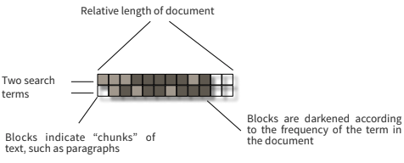
Text text searches
TileBars
Graphical representation of term distribution and overlap
Indicates relative document length
Frequency of term sets in document
Distribution of term sets with respect to length of the document and each other.
Issues
Horizontal alignment doesn’t match mental model of length documents: documents don’t really get “wider” (horizontal), they get “longer” (vertical).
May not be the best solution for web searches. (It doesn't account for non-text forms of media that are available on the internet, like images or apps. Each tile represents a block of text, its unclear how TileBars would scale to handle those types of data

Slide 29
Text text searches
Sparkler
How good is the quality or similarity of the search result to my query? (How strong the match is)
Show distance from query in order to give user better feel for quality of matches (document rank).
Can also visualize multiple queries (distance of documents to multiple queries)
For visualizing each query:
Triangle – query
Square – document
Distance between query and documents represents their relevance (compare between results)

Slide 30
Text text searches
Another idea: use this to compare results from different search engines.
Each dimension does not represent a different query.
Instead, it represents the results coming from a different search engine with the same input query.

Slide 31
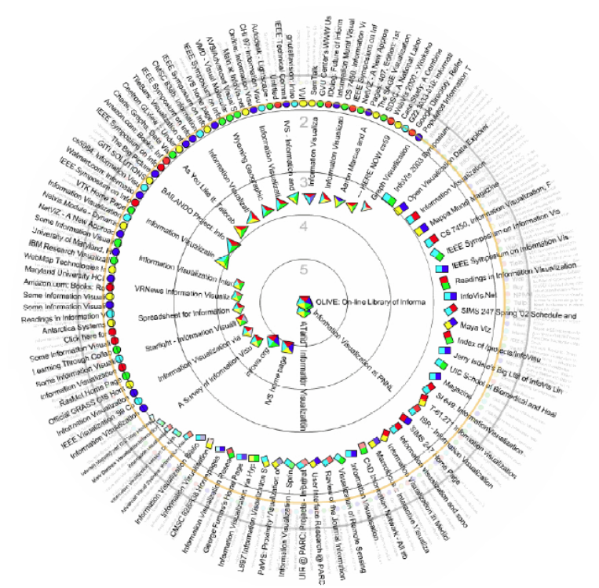
Text text searches
RankSpiral
Place consecutive document icons next to each other so that they do not overlap
Total ranking score of documents increases toward the center. (The more closer to center, the more closer the result is with the query).
Each icon can have one to four colors, representing if it’s selected by a certain search engine as a result of the query.

Slide 32
Text Infovis for sentences, words, phrases
Move beyond just search/IR
Main goal of understanding versus search
Drawbacks of word clouds/wordles
>_<: Interaction is limited - Word Clouds and Wordles are really more overview-style visualizations, don’t really support queries, searches and drill-down.
>_<: Words’ position in word clouds has no meaning
>_<: Words’ size was artificial at times (word length confounds size)

Slide 33
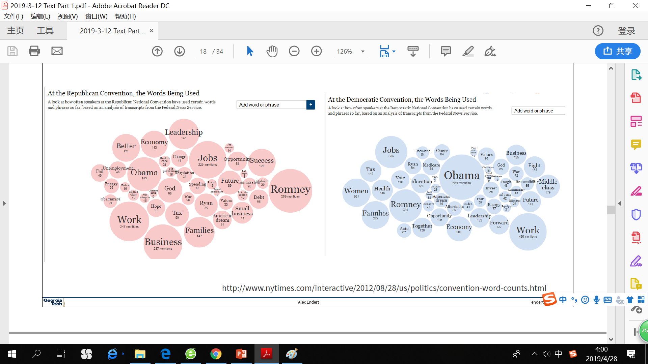
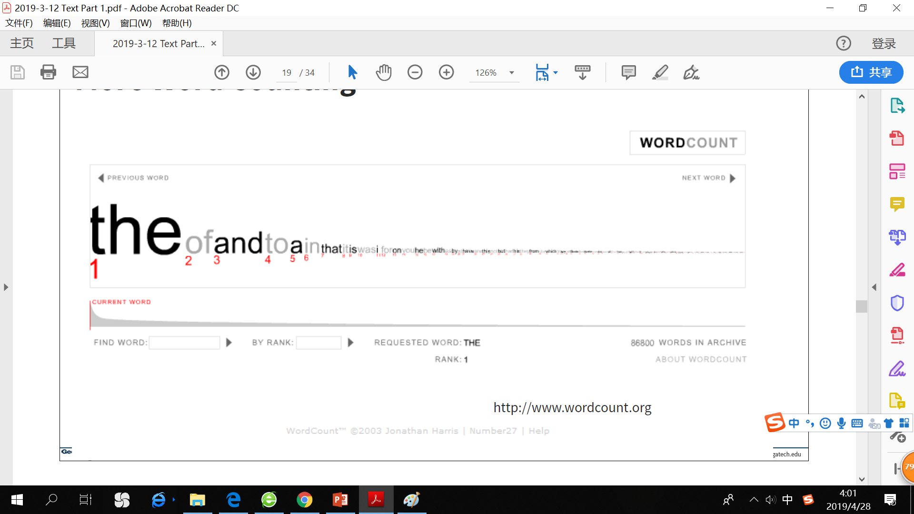
Text Infovis for sentences, words, phrases
Word Counts

Slide 34
Text Infovis for sentences, words, phrases
Tag/Word clouds
Idea is to show word/concept importance through visual means.
Tags: user-specified metadata (descriptors of documents).
Serve as social signifiers
Provide a friendly atmosphere that provide a point of entry into a complex site
Sometimes generalized to just reflect word frequencies.

Slide 35
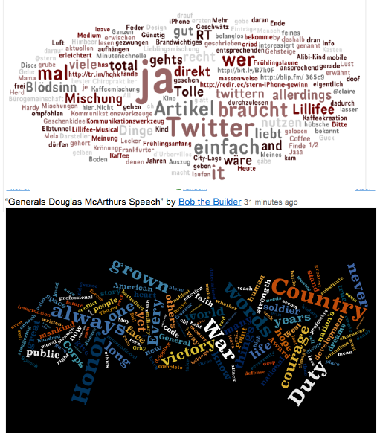
Text Infovis for sentences, words, phrases
Wordle
Tightly packed words, sometimes vertical or diagonal
Word size is linearly correlated with frequency
Multiple color palettes
User gets some control
Layout algorithm
Sort words by weight in decreasing order.
For each word w do:
w.position = makeIntialPosition(w)
while w intersects with other words: updatePosition(w)
Initial position is chosen randomly according to distribution for target shape.
Update position moves out radially.

Slide 36
Text Infovis for sentences, words, phrases
A little more order: put similar words closer together
Some fun uses of Wordles: songs, poems, wedding vows, course syllabi...
Problems – actually not a great visualization >_<
Hard to find a particular word
Long words get increased visual emphasis (long words take more space, but longer words are not “more important”)
Font sizes are hard to compare
Alphabetical ordering not ideal for many tasks

Slide 37
Text Infovis for sentences, words, phrases
Multiple documents
Parallel Tag Clouds
DocuBurst
Sets of synonyms grouped together
Size: number of leaves in subtree
Hue: different synsets of word
Shade: frequency of use

Slide 38
Text beyond individual words
Word Tree
Follow word with all the phrases that follow it
Font size shows frequency of appearance
Continue branch until hitting unique phrase
Clicking on phrase (a node) makes it focus (truncate the tree, only show the subtree rooted from that word.
Can be ordered alphabetically, by frequency, or by first appearance.
Phrase Nets
Nets do not typically have one root.
They can have cycles, edges going back and forth.
Presents pairs of terms from phrases such as: X and Y, X’s Y, X at Y, X is/are/was/were Y, X of Y.
Uses special graph layout algorithm with compression and simplification.

Slide 39
Text beyond individual words
Word Tree

Slide 40
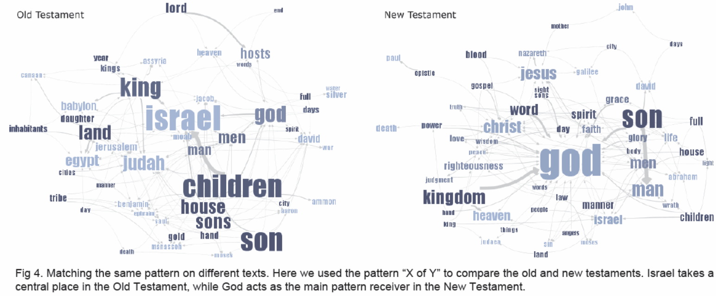
Text beyond individual words
Phrase Net

Slide 41
Text beyond individual words
SentenTree
Add sentence structure to word cloud to give this more meaning (combine word clouds with sentence structure).
Think of it as a word tree that goes toward both directions for every word.

Slide 42
Text visualize a collection of documents
Document analysis metrics
Average word length
Syllables per word
Average sentence length
Percentage of nouns, verbs, adjectives
Frequencies of specific words
Hapax Legomena – number of words that occur once
Document metadata
Document entities
Connections between documents
Documents concepts and themes

Slide 43
Text visualize a collection of documents
HeatMap
Readability Metrics: ease of sentence reading, based on vocab difficulty, sentence structure, etc (provide quantitative measures of readability).
Each metric encoded to heatmap color range to determine the readability of the sentence, gave an understanding of why a sentence was hard to read.
Good at determining what parts of a document are less readable.
Features used:
Word length
Vocabulary complexity
Nominal forms
Sentence length
Sentence structure complexity

Slide 44
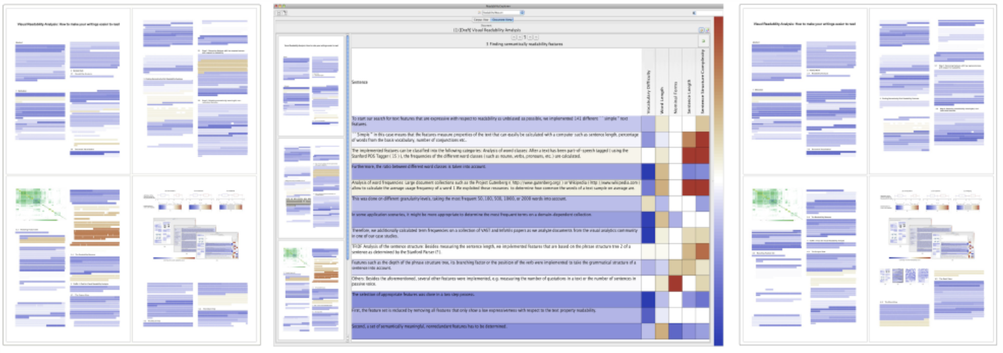
Text visualize a collection of documents
Each block represents a contiguous set of words.
Do partial overlap in blocks for a smoother appearance.

Slide 45
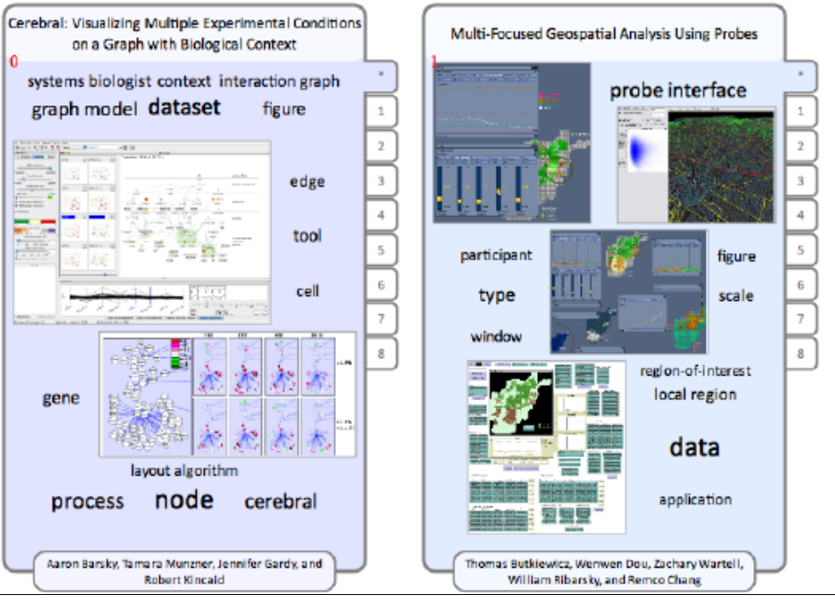
Text visualize a collection of documents
Document Cards
Compact visual representation of a document
Show key terms and important images

Slide 46
Text visualize a collection of documents
Bohemian Bookshelf
Really about casual browsing
Serendipitous browsing

Slide 47
Text visualize a collection of documents
Jigsaw
In contrast to Bohemian Bookshelf, Jigsaw targets sense-making scenarios.
Variety of visualization ranging from word-specific, to entity connections, to document clusters.
Primary focus: entity-document connection & entity-entity connection.
Search capacity coupled with interactive exploration.

Slide 48
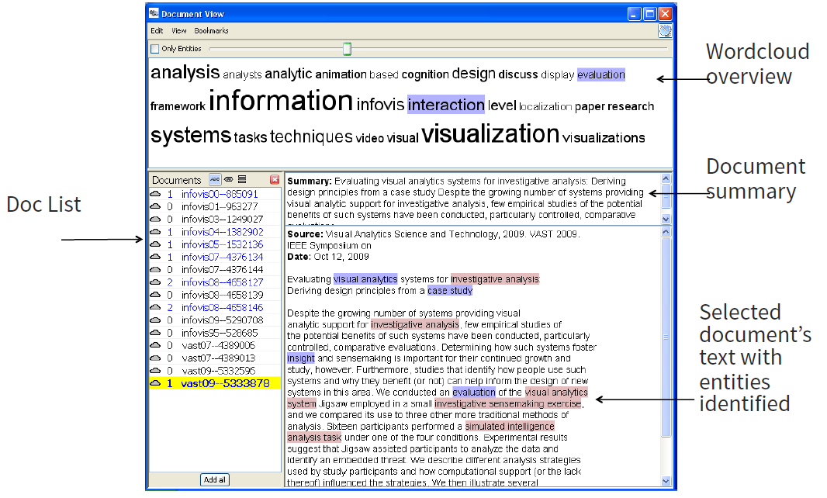
Text visualize a collection of documents
Document view
Document Cluster view

Slide 49
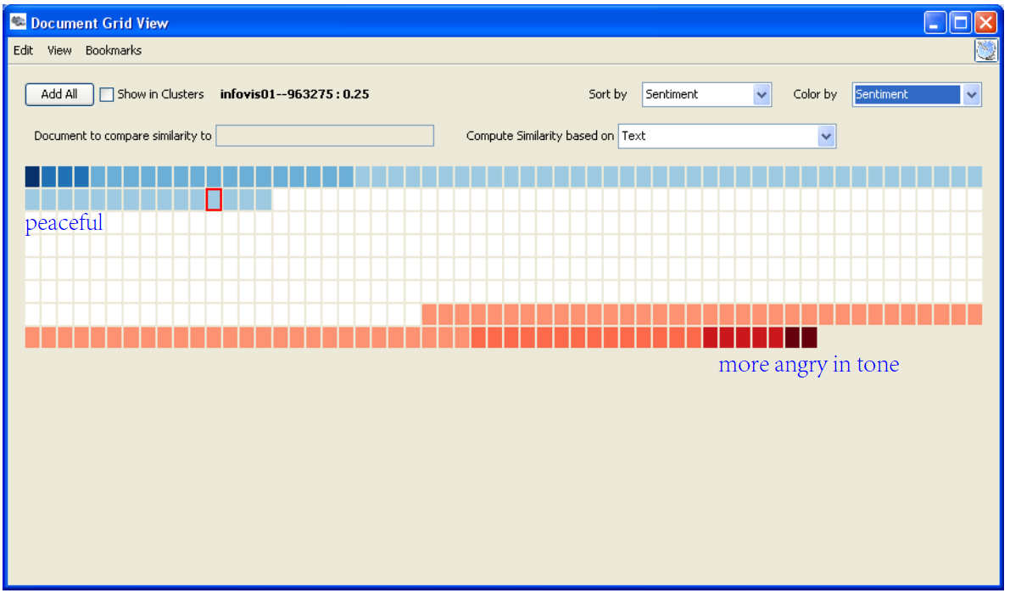
Text visualize a collection of documents
Document Grid view
Show sentiment analysis of docs
Calendar view
A nice temporal view of what different entities are “doing” at different times.

Slide 50
Text visualize a collection of documents
List View
Black rectangle before each entitiy represents the number of times an entity appears across documents.
Yellow indicates a highlighted entity. Orange indicates entities that appear in the same documents as the selected entity. The darker the orange, the stronger the connection.
The authors highlighted in orange means they appear in the same documents as John Stasko.

Slide 51
Text visualize a collection of documents
Facet Atlas
Show entities and concepts connect in a document collection
Visualizes both local and global patterns
Facet: class of entities
Clusters: groups of similar entities in a facet
Similarity: encoded by distance between terms
Relations: connections between entities

Slide 52
Text contents, semantics, themes
Vector Space Analysis
How does one compare the similarity of two documents?
Make list of each unique word in document
Throw out common words
Make different forms the same (bake, bakes, baked)
Store count of how many times each word appeared, make it into a vector
Cosine similarity
Use a mass-spring layout algorithm to position representations of each document
Some similarities to how search engines work
Not all words are equal
TFIDF = Term Frequency * Inverse Document Frequency
Weights of words increases if it appears often in a document, but not often in the collection

Slide 53
Text contents, semantics, themes
VIBE System
Smaller sets of documents than whole library
Idea is to understand contents of documents relate to each other
Points of interest: terms or keywords that are of interest to user
In the vis, each document’s relation to points of interest is shown
Also visualize how documents are similar or different
Technique
Represent points of interest as vertices on convex polygon
Documents are small points inside the polygon
How close a point is to a vertex represents how strong that term is within the document.

Slide 54
Text contents, semantics, themes
^_^:
Effectively represent relationships
Straightforward methodology and vis are easy to follow
Scalable: can show relatively large collections
>_<:
Not showing much about a document
Single items lose “detail” in the representation
Starts to break down with large number of terms (does not scalable in terms of # points of interest)

Slide 55
TEXT PNNL
Galaxies
“Two levels of similarity”
1. Representation of documents where similar ones cluster together.
2. Closer clusters are more similar to each other than clusters far away.
Themescapes
2D maps didn’t reflect density of regions all that well
Use 3D representation, and have height represent density or number of documents in region
>_<: Gives no indication of the chronology

Slide 56
TEXT PNNL
ThemeRiver
Can show themes and how they rise or fall over time
Each band/current is a topic or theme
Width of band is “strength” of that topic in documents at that time

Slide 57
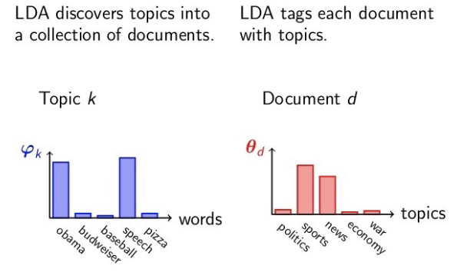
Text topic modeling
Latent Dirichlet Allocation
Phi(k): word distribution of topic k (each topic is modeled by sets of words/terms).
Theta(d): topic distribution of document d.

Slide 58
Text topic modeling
TIARA
Keeps basic ThemeRiver metaphor
Embed word clouds into bands to tell more about what is in each
Each layer represents a topic, which is described by a set of keywords
Topic keywords are distributed along the time, summarizing the topic content and the evolution of content over time.
Magnifier lens for getting more details
Uses Latent Dirichlet Allocation to do text analysis and summarization

Slide 59
Text topic modeling
TextFlow
Show how topics merge and split
TexTonic
Back to word clouds
But this time, position does have meaning: closer words are similar in the vector space

Slide 60
Graphs & networks graph terminology
Graphs can have cycles
Graph edges can be directed or undirected
The degree of a vertex is the number of edges connected to it (in-degree and out-degree for directed graphs)
Graph edges can have values on them (nominal, ordinal or quantitative)
Edges don’t have to be straight
Nodes can also have values - use encodings to show vertex, such as: shape, color, size, location, label

Slide 61
Graphs & networks graph visualization challenges
Graph layout and positioning
Make a concrete rendering (翻译) of abstract graph.
Navigation & Interaction
How to support user changing focus and moving around the graph.
Scale
May run out of space or slow down the algorithm.
The two issues above are not too bad for small graphs, but for large ones are much tougher.

Slide 62
Graphs& networks aesthetic considerations; edges
Minimize crossings
Minimize total edge length (toward proper scale) 不能无限的缩小图
Area – minimize towards efficiency
Minimize the longest edge length
Minimize edge length variance (Uniform edge length)
Total bends – minimize orthogonal towards straight-line
!!! While aesthetic, these considerations also impact the fundamental usability and effectiveness of graphs.

Slide 63
Graphs & networks shneiderman’s netvis nirvana (涅槃)
Every node is visible
For every node, you can count it’s degree
For every link you can follow it from source to destination
Clusters and outliers are identifiable

Slide 64
Graphs & networks User tasks for graph vis
Start with Amar et al ‘05 low-level tasks’ (they still apply).
Add four types of graph-specific tasks
1. Topology-based tasks
Adjacency – find the set of nodes adjacent to a node
Accessibility – find the set of nodes accessible to a node
Common connection – given nodes, find the set of nodes connected to all
Connectivity – find shortest path; identify clusters; identify connected components

Slide 65
Graphs & networks User tasks for graph vis
2. Attribute-based tasks
On the nodes – find the nodes having a specific attribute value
On the edges - find the nodes connected only by certain kinds of edges
3. Browsing tasks
Follow a given path
Revisit – return to a previously visited node
4. Overview tasks
Compound exploratory task such as estimating size of a network, finding patterns, etc.

Slide 66
Graphs & networks graph layout approaches
Layout heuristics
Polyline edges
Planar (平面的)
Orthogonal
Grid-based
Curved lines
Hierarchies
Circular
Scale challenge
May run out of space for vertices and edges (变成一团乱麻)
Sometimes use clustering to help
Extract highly connected sets of vertices
Collapse some vertices together
Navigation & Interaction challenge
How do we allow a user to query, visit, or move around a graph?

Slide 67
Graphs & networks graph layout techniques
Circular layout
Space vertices out around border of a circle. (may place nodes with equal distance along the verge of the circle)
Arc Diagram layout
Draw edges across the top or bottom.
May have directed graph: all edges across the top are going from left to right, and all edges across the bottom are from right to left (clockwise overall).
Can be redundant on the other side if the graph is undirected.
Tree layout
Run a breadth-first search from a vertex
Simple and fast, but obviously doesn’t represent the whole graph

Slide 68
Graphs & networks graph layout techniques
Hierarchical layout
Try to impose hierarchy on graph → put nodes into layers or levels.
Reverse edges if needed to remove cycles.
Introduce dummy nodes (the bends in the edges correspond to dummy nodes).
Force-directed layout
Example of constraint-based layout technique → impose constraints on layout (such as shorten edges, minimize crossings, etc).
Define through equations.
Create optimization algorithm that attempts to best satisfy those equations.

Slide 69
Graphs & networks graph layout techniques
Common: Spring model
Edges – springs (gravity attraction)
Vertices – charged particles (repulsion)
Constraints - equation for forces
Seek local minimum of energy – sum of forces on each node is zero
Mass-spring layout: Uses a simulation in which related entities are conceived of as having springs connecting them, with the strength of the spring proportional to the calculated relationship between the two entities. Mass-spring layout algorithm uses this physical simulation to position a visual representation of each document so as to approximate all of the pairwise distances between documents.

Slide 70
Graphs & networks one particular challenge with graphs
Data often does not come in “graph model”
Nodes and edges may not be pre-defined
Users have to “define” what they want to be nodes, then define the relation between them (edges).
Some tools help you do this
Ploceus
User select attributes to define edges. If two nodes share the same attribute value, use an edge to connect them.
Graphiti
What if you don’t know the attributes that correspond to the relationship you what to define?
I want a graph that has these two nodes connected. The system searches and creates edge rules that help form this graph.

Slide 71
hierarchies & trees overview
Data repository in which data cases are related to sub-cases.
Can be thought of as imposing an ordering in which items are parents or ancestors of other items.
All nodes have in-degree of 1, except the root node, which does not have an in-degree.
Leaf nodes have out-degree of 0.
Binary tree has out degree maximum = 2.
Hierarchies often represented as trees
Subcase of general graph
Directed graph with no cycles

Slide 72
hierarchies & trees visualizing trees – four methods
Node-link
Height on separate levels
Width in unique columns – make room for subtrees upwards
Potential problems
For top-down, width of fan-out uses up horizontal real estate very quickly
Tree might grow a lot along one particular branch
SpaceTree
Aggregation of sub-trees into triangles.
Size of triangles indicates depth.
Shading indicates number of noes inside the subtree.
Navigate by clicking on nodes
→ strongly restricted zooming.

Slide 73
hierarchies & trees visualizing trees – four methods
ConeTree
3D approach
Children of a node are laid out in a cylinder below the parent.
^_^: More effective area to lay out the tree, aesthetically pleasing (if done correctly).
>_<: As in all 3D, occlusion obscures come nodes.
>_<: Interaction/navigation may lead to usability issues.

Slide 74
hierarchies & trees visualizing trees – four methods
Hyperbolic Browser
Why put root on the top? Root can be at center with levels growing outward.
Distance decreases between parent and child as you move farther from center.
Approach: lay out the hierarchy on the hyperbolic plane and map this plane onto a display regions.
Start with the tree’s root at the center.
Clicking on the blue node brings it into focus at the center.
Use animation to navigate along this representation of the plane.
>_<: Watching the view can be disorienting.
>_<: Not as symmetric and regular as Euclidean techniques, two important attributes in aesthetics.

Slide 75
hierarchies & trees visualizing trees – four methods
Degree-of-interest Trees
Approach: use fisheye-like focus & context ideas to control how a tree is drawn
Clustered representation of large unexpected branches

Slide 76
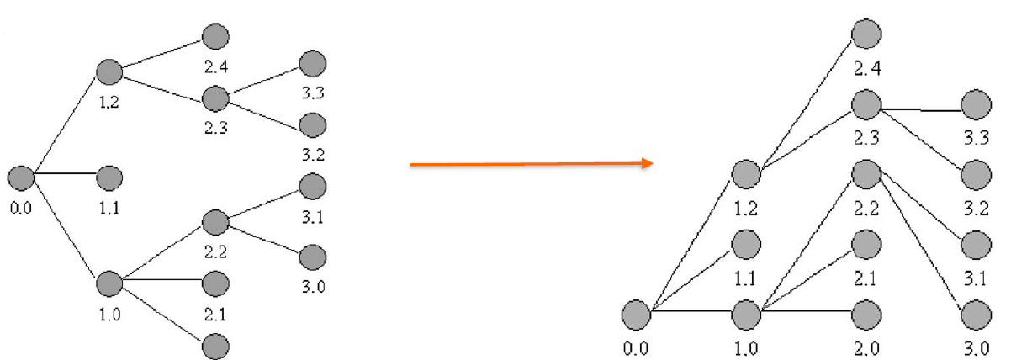
hierarchies & trees visualizing trees – four methods
FlexTree
Horizontally-drawn tree with compression along vertical dimension.
Basic idea: push all nodes down as far as you can.

Slide 77
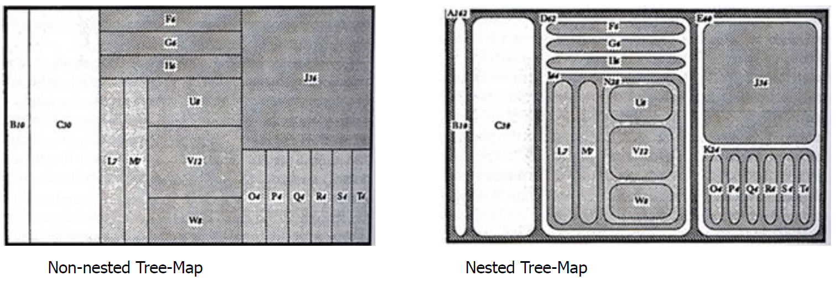
hierarchies & trees visualizing trees – four methods
Space-Filling
Each item occupies an area.
Children are “contained” under parent.
Alternate horizontal and vertical slicing at each successive level.
Use the relative size of area to encode other variable of data items.
TreeMap
Object-oriented software classes
File/directory structures
Animal kingdom

Slide 78
hierarchies & trees visualizing trees – four methods
Context Treemap – Treemap with small distortion
Nodes with zero value problem - Zero values have zero mapped area, but you still want to see them.
Give zero-valued items some constant proportion of screen area.
Provide dynamic query capabilities to enhance exploration leading to portfolio diversification (资产组合多样化).

Slide 79
hierarchies & trees visualizing trees – four methods
Radial Space-Filling
SunBurst – for file/directory structures
Root directory at center, each successive level drawn farther out from center.
Sweep angle of item corresponds to size.
Color can encode another attribute (file type or age).
Interactive controls for moving deeper in hierarchy, changing the root.
Double click on directory makes it a new root.

Slide 80
hierarchies & trees visualizing trees – four methods
Hybrid Approaches – Mix node-link and space-filling
EnCon
Explicit combination of node-link and treemap-like techniques.
Partition space into hierarchical regions, then draw node link into that.
How to decide between node-link and space-filling?
It depends on the properties of the data
Node-link typically better at exposing structure of information structure
Space-filling is good at focusing on one or two additional variables of cases.

Slide 81
hierarchies & trees visualizing trees – four methods
Connectivity matrix
For example, 12 nodes in a tree, then the matrix would be 12*12 binary.
Indented list

Slide 82
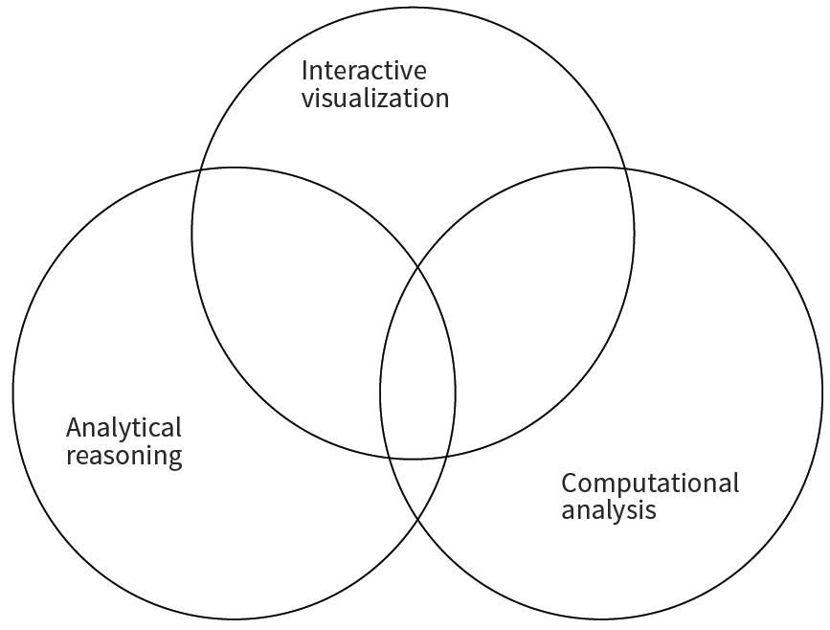
Visual analytics overview
Visual analytics is the science of analytical reasoning facilitated by interactive visual interfaces.
Alternate definition: visual analytics combines automated analysis techniques with interactive visualizations for an effective understanding, reasoning and decision making on the bases of very large and complex dataset.

Slide 83
Visual analytics recommendations
Integrate data mining and information visualization.
Allow users to specify what they are seeking.
Recognize that users are situated in a social context.
Respect human responsibility.

Slide 84
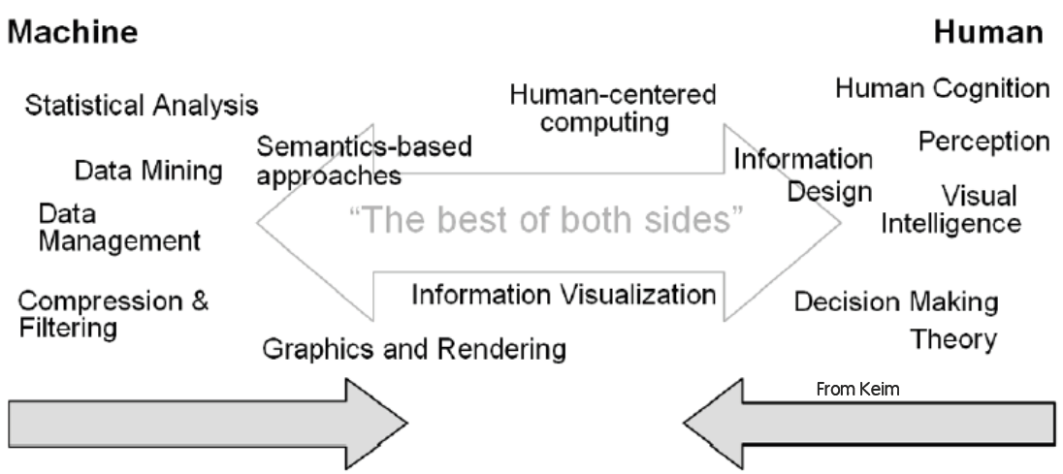
Visual analytics synergy
Combine strengths of both human and electronic data processing.
Gives a semi-automated analytical process
Encompassing, integrated approach to data analysis
Use computational algorithms where helpful.
Use human-directed visual exploration where helpful.
Not just “Apply A, then apply B”, but integrate the two tightly.

Slide 85
Visual analytics integrate data mining and Infovis
Dimension reduction
Computational techniques to solve for similar attributes to reduce the number of attributes used to describe the dataset.
For VA, often reduce from n, to 2, because that opens up to a whole bunch of useful visualization tools.
There are loss associated with compressing the dimensionality.
Why use dimension reduction?
Direct focus towards more relevant attributes.
Can clean up or organize a vis with a lot of attributes.

Slide 86
Visual analytics integrate data mining and Infovis
PCA
Frequently used deterministic technique
Solve for maximum variance
>_<: no guarantee that resulting PCs are “meaningful”. Max variance may not be most meaningful.
>_<: Sensitive to outliers
>_<: Linear function. What if data/phenomena is non-linear?
Feature selection – entity extraction
TFIDF for entity selection/extraction, commonly used way to apply structure and weighting to unstructured text. With structure, we can compute and visualize.
Similarity functions – find more like this
Prediction

Slide 87
Visual analytics incorporating human feedback
Unsupervised computation is rarely the “final” solution.
“human-in-the-loop” design advocates for including user feedback in the holistic system.
People have domain expertise, can balance subjective tradeoffs.
Warning!
Do not treat user interaction as an easy way out.
Do not make your problems (as developers and designers) the user’s problems.
Interaction should be meant to explore data, ask questions and gain insight.

Slide 88
Visual analytics recovering reasoning process
User interaction is valuable “data” – quantitative record of analysis and exploration process.
What can be learn form this data? – “interaction is the insight”.
We can systematically analyze the user interaction in the system at runtime to steer models.
Instead of asking users to directly tune and parameterize models, how can systems learn from their exploratory user interactions?
How can we use the interactions that people have done to steer the models and the visualizations directly?

Slide 89
Visual analytics evaluating a visualization is hard
There is no standard to evaluate against
Context is important
There are different strengths built for different purposes
Not all data are equal

Slide 90
D3
Discuss purpose of D3 lifecycle
D3 lifecycle has three states: enter, update and exit.
Animated transitions can be defined for these three states.
It can be used to manipulate animated update for DOM elements.

